Slide 1
RANDOMIZED LEAST SIGNIFICANT BIT(LSB) EMBEDDING IMAGE STEGANOGRAPHY WITH ADVANCED ENCRYPTION STANDARD(AES) ALGORITHM
Project Supervisor:
Dr.K Madhuri
Associate Professor
Team Details:
TEAM- 1
G M S Padmini (20EG105415)
B Vaishnavi (20EG105406)
CH Shreya (20EG105407)

Slide 2
Introduction
The "Randomized Least Significant Bit(LSB) Embedding Image Steganography with Advanced Encryption Standard (AES)" project is a combination of Image Steganography and AES Encryption technique along with Randomization.
The developing environment is Python 3.11 and Command prompt.
It allows confidential information to be securely hidden within digital images, ensuring privacy and confidentiality during data transmission.
The applications span various domains, including secure communication, digital forensics, privacy protection.

Slide 3
Problem Statement
Conventional methods of data transmission often lack the desired level of privacy, making sensitive information vulnerable to interception. These methods of sending data can be intercepted or compromised, posing a risk to sensitive information and are subjected to various security threats, including brute force attacks, Chosen Plaintext attacks, Known Plaintext attacks.
The objective of the Project is to address these privacy and security concerns by combining Steganography and Encryption methods. The aim is to create a Seamless and Secure channel for transmitting confidential information without arousing suspicion while also ensuring data integrity. This fusion of techniques seeks to provide a better solution for protecting sensitive information during transmission.

Slide 4


Proposed Method
The proposed method is “Randomized Least Significant Bit (LSB) Embedded Steganography with Advanced Encryption Standard(AES) Algorithm”.
INPUTS: Image
Message
Password.
Here, user has to decide the options 1 or 2 for :
1. Encrypt and Encode the Text
2. Decode and Decrypt the Text

Slide 5
Proposed Method
For the option 1: Encrypt and Encode the Text
Firstly, check if the image is in PNG Format. If not we cannot use other Formats.
We will check if the image is RGB mode, if not we need to convert it.
The provided password must be of at least 12 characters.
With the given password, we will do Password Key Derivation where we use SHA-256 to get 256 bit key hash value which is used as encryption key for AES Encryption.
We will also ask to give the message and we should do Padding.
The padded plaintext is Shuffled.
SHUFFLING THE BITS: ( In this case we are using this method, we can use any other way of shuffling also)
The last 4 bits of the data are rearranged to occupy the first 4 positions, while simultaneously, the first 4 bits are moved to the last 4 positions.

Slide 6
After Shuffling the bits we will perform AES - 256 ENCRYPTION.
AES ENCRYPTION:
1.AES algorithm is used in Cipher Block Chaining (CBC) mode which takes Derived Key and Initialization Vector (IV) as inputs.
2. An initialization vector (IV) is an arbitrary number that can be used with a secret key for data encryption.
3. Initialization vector, XOR operation adds extra layer of security to use CBC mode.
4. Derived Key is 256 bit length.
5. AES works on 128 bit length fixed length block so the message is divided into 128 bit length blocks.

Slide 7
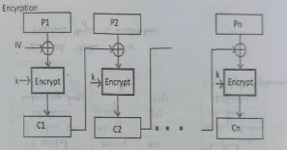
CBC MODE
The final cipher text is obtained is in the form of bytes where we convert the message to individual bits by keeping them in the form of a list.
APPENDING TO IV:
The resulting ciphertext is appended to IV.
BASE 64 ENCODING:
Then the ciphertext is finally encoded with BASE-64 encoding where 6 binary bits are grouped together and among the predefined 64 characters: A-Z, a-z, +, /, 0-9.
The Base 64 Encoding is done.

Slide 8
HEADER TEXT INSERTION:
→ Header Text is encoded along with the cipher text.
→ Header Text is is a predefined string that is used as a marker or identifier at the beginning of the hidden message.
→ The length of the Header Text is 10 characters or bytes - “HeaderText”.It’s purpose is to distinguish between the header (marker) and the actual encrypted message within the image.
→ The header is shared among the Sender and Receiver.
→ When decoding an image, the code checks whether the header text is present at the beginning of the decoded data. If it is not found or does not match the expected header text, the code considers the data invalid. This helps to ensure the integrity of the encoded message.

Slide 9

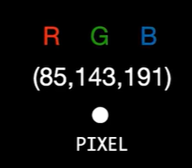
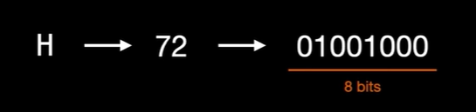
LSB ENCODING:
For example, in the steganography process, if the message bit to encode is “H” then the procedure is as follows:
Each pixel has 3 colours - Red, Green and Blue
The image is made up of pixels
Each character is converted to the corresponding ASCII value and converted to 8 bits.

Slide 10
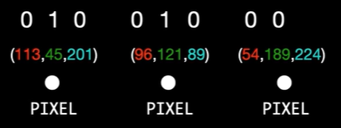
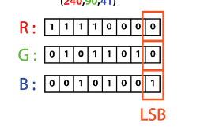
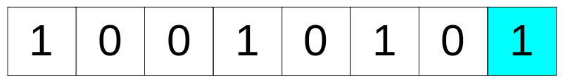
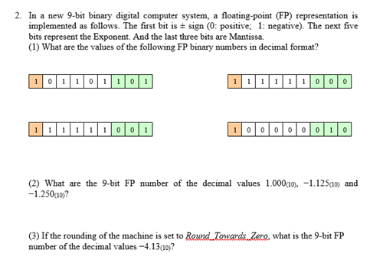
Each character needs 3 pixels to encode it
LSB in each colour of the pixel
→ Message bits
→ 3 Pixels RGB Colours LSB
If the message bit is ‘0’ then value of LSB of the colour of pixel must be ‘0’
If the message bit is ‘1’ then value of LSB of the colour of pixel must be ‘1’
9th bit is called as “STATUS BIT”. (3rd pixel’s blue LSB )
9th bit should be ‘0’ if the message continues or make it as ‘1’ if the message ends with that character.

Slide 11
For the option 2: Decode and Decrypt the Text
LSB DECODING :
The code iterates through the pixel data of the encoded image. For each
pixel, it reads the least significant bits (LSB) of the RGB values.
HEADER TEXT VALIDATION:
Header Text is validated from the decoded text. If the decoded text is having the headertext as “HeaderText”. Then we continue to do further steps.
BASE-64 DECODING :
Then the ciphertext is finally decoded using BASE-64 encoding.

Slide 12
REMOVE THE IV:
The IV is removed from the ciphertext that is decoded.
DECRYPTING BY AES-256 DECRYPTION:
1. This process takes the same key used for encryption.
2. It extracts the IV from the beginning of the data and uses it to initialize.
3. The decrypted data is then unpadded to remove the padding bits which are added during encryption.
4. The bits are converted into bytes which in turn is converted to ASCII Text and the corresponding original message is obtained.

Slide 13
UNSHUFFLING THE BITS:
The last 4 bits of the data are rearranged to occupy the first 4 positions, while simultaneously, the first 4 bits are moved to the last 4 positions.
UNPAD THE TEXT:
We will Unpad the bits and finally display the Final Text.
This is the Proposed Method which includes Encrypting and Encoding the Text and also Decoding and Decrypting the Text.

Slide 14
Experiment Environment
The environment used is PYTHON IDLE & COMMAND PROMPT
The packages used in our Python code is:
PILLOW PACKAGE: Used for image processing, to open, manipulate and save various image formats.
OS PACKAGE: To interact with the operating system.
PYCRYPTODOME PACKAGE: Used in the code for AES, SHA-256, RANDOM
BASE-64 PACKAGE: Used for particularly in image steganography without causing issues when we use character encoding or special characters.
TERMCOLOR PACKAGE: Used to add the color text, various background colors to output console. Here, we use cprint() function which is used to print the text with different styles and colours.

Slide 15
PYFIGLET PACKAGE: To create ASCII text and attractive headers using font and width
GETPASS MODULE: To read passwords and ensure the passwords and sensitive data is not exposed.
SYS PACKAGE: To work with Python runtime Environment
RANDOM PACKAGE: For the generation of IV
TIME MODULE: To calculate the encryption and decryption time
BINASCII MODULE: To work with binary and ASCII encoded data
NUMPY PACKAGE: To work with arrays or matrices
SCIKIT-IMAGE PACKAGE: For calculating image quality metrics, specifically PSNR (Peak Signal-to-Noise Ratio) and MSE (Mean Squared Error).
OPENCV PACKAGE: For computer vision tasks and image processing.
MATPLOTLIB.PYTPLOT: To create plots and visualizations.

Slide 16
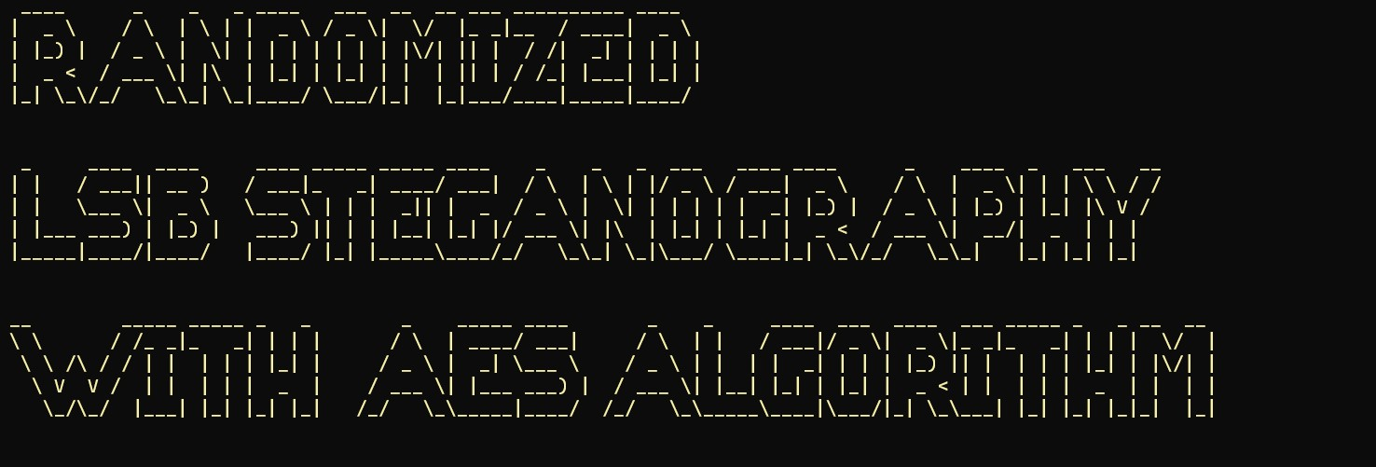
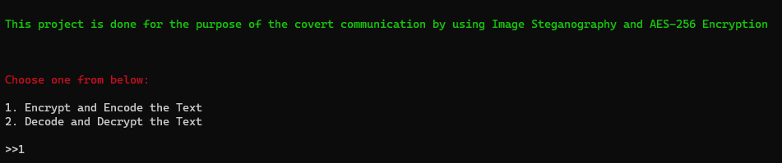
Experiment Screenshots
[1]
[2]

Slide 17
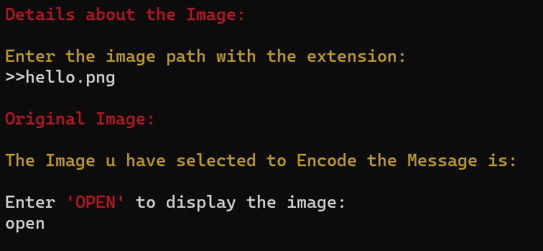

[3]
[4]

Slide 18
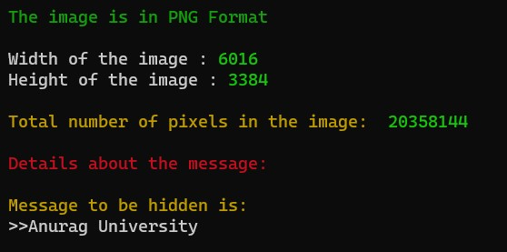
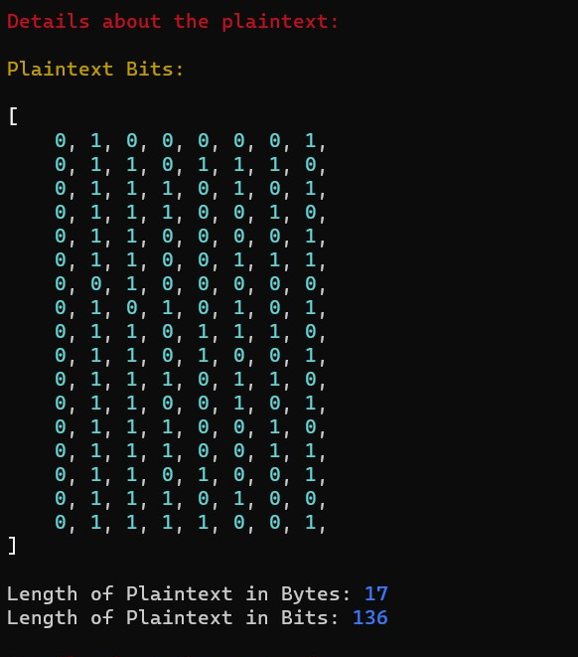
[5]
[6]

Slide 19
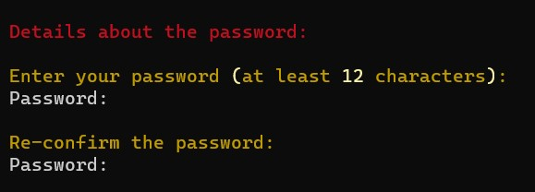
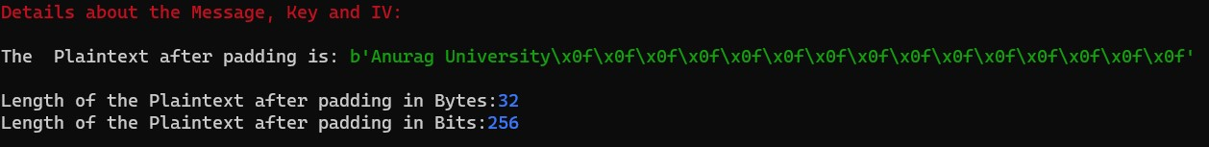
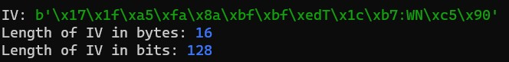
[7]
[8]
[9]
[10]

Slide 20
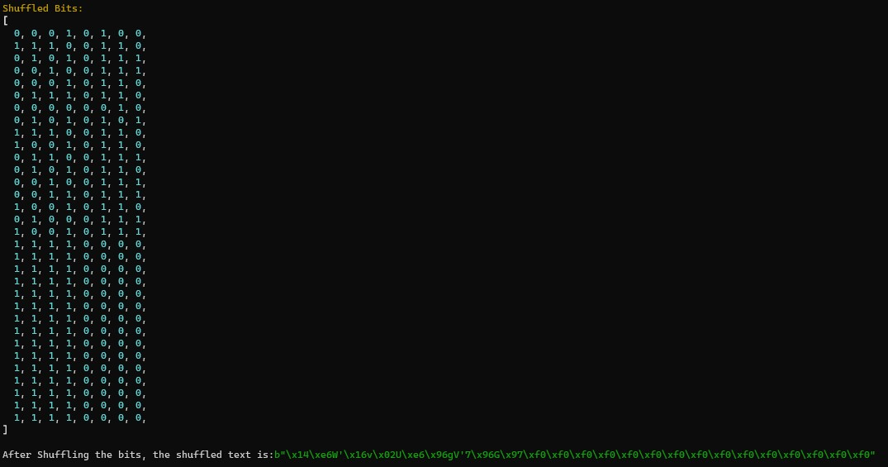
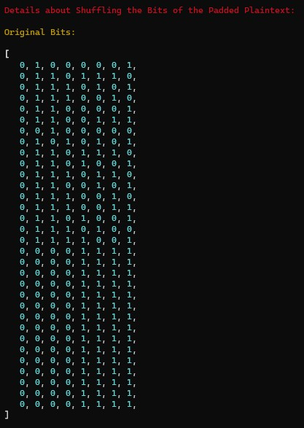
[11]
[12]

Slide 21
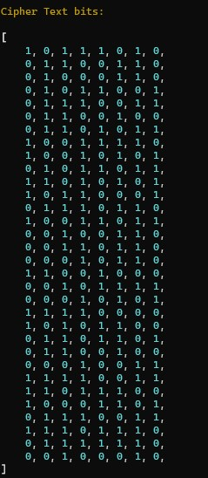
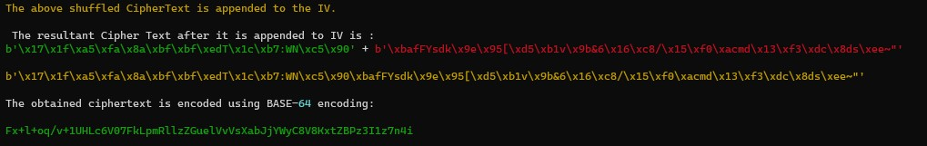
[13]
[15]
[14]

Slide 22
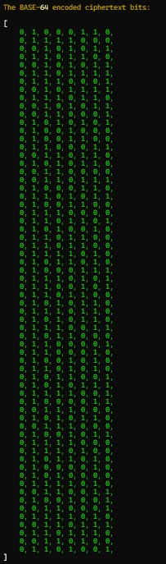
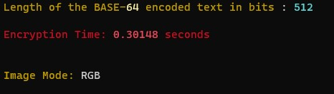
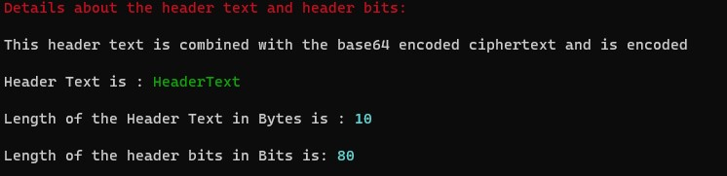
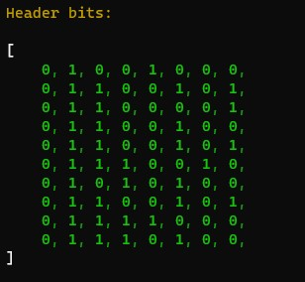
[16]
[17]
[18]
[19]

Slide 23
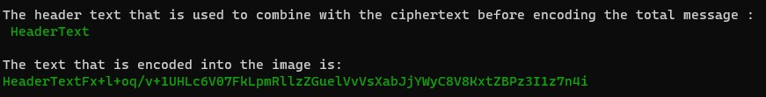
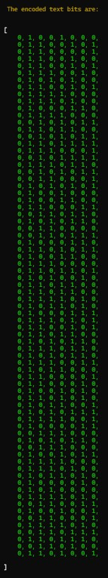
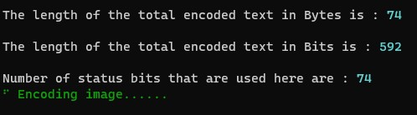
[20]
[22]
[21]

Slide 24
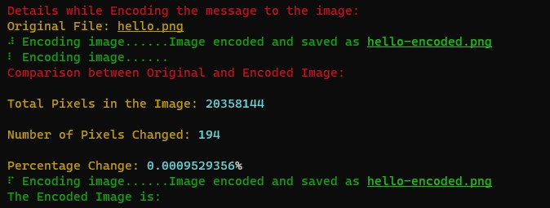

[23]
[24]

Slide 25
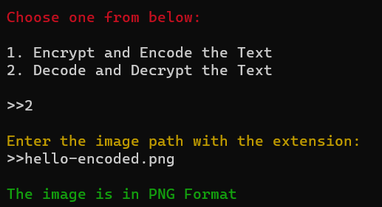
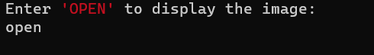
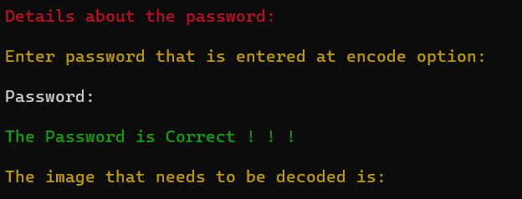
[25]
[27]
[26]
[28]

Slide 26
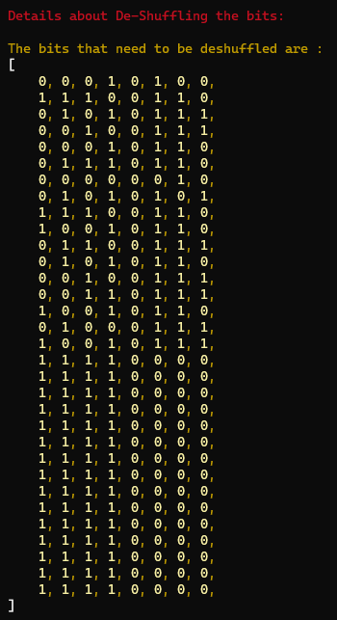
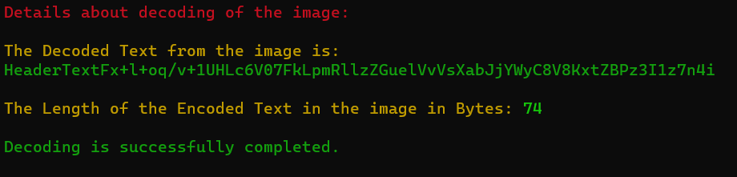
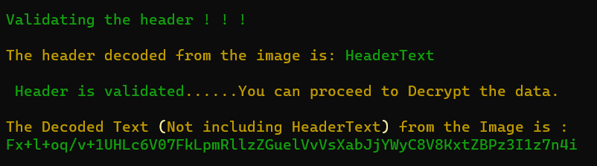
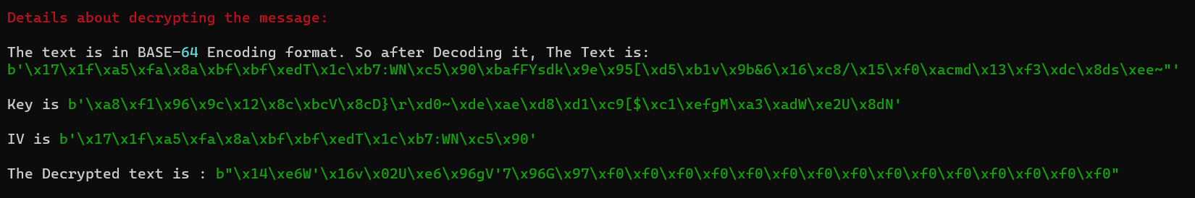
[29]
[32]
[30]
[31]

Slide 27
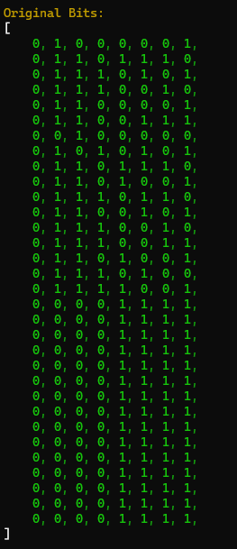
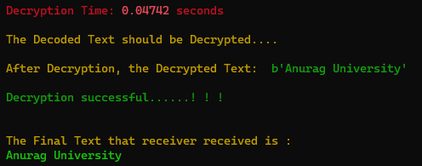
[34]
[33]

Slide 28
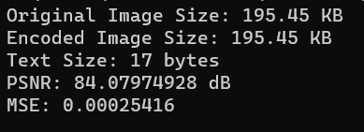
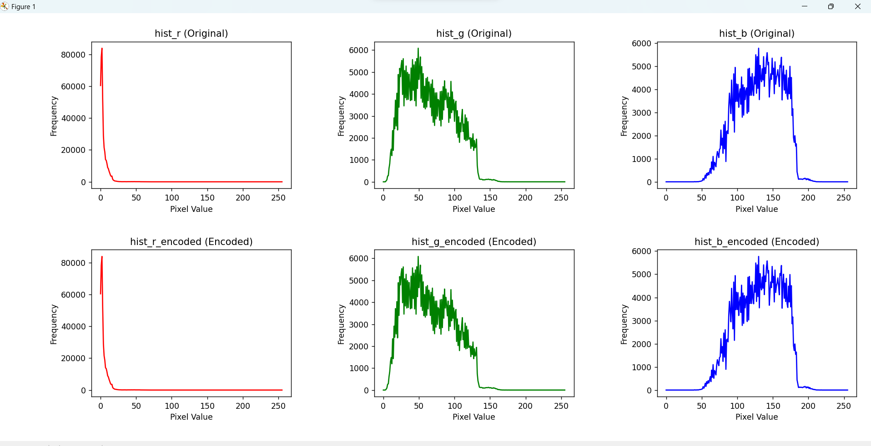
Experiment Results

Slide 29
Experiment Results
IMAGE SIZE | Input Message Size (bytes) | Previous PSNR (db) | Previous MSE values | Resulting PSNR (db) | Resulting MSE
195.45 KB | 17 | 79.578964697 | 0.01597856 | 84.07974928 | 0.00025416
195.45 KB | 600 | 71.754545656 | 0.31054630 | 74.06923367 | 0.00254775
195.45 KB | 800 | 67.31343648 | 0.30074563 | 71.36014589 | 0.00289910
195.45 KB | 1000 | 64.97885460 | 0.45282360 | 68.45697802 | 0.00407123

Slide 30
Experiment Results

Slide 31
Finding
We found that “Randomized Image Steganography with AES Algorithm” is secure against Chosen-Plaintext attack, Differential Cryptanalysis, Known- Plaintext attacks.
Example: If the message that is to be encoded without shuffling is “HELLO” then The ASCII values of the characters in "HELLO" are [72, 69, 76, 76, 79]. In the original image, you replace the least significant bit (LSB) of each color channel (R, G, B) with the corresponding bit of the ASCII values. But it is not possible to succeed these attacks as we are doing “Randomization through Shuffling”, “BASE-64 Encoding”, etc.
Here, we are using Randomization through Shuffling the bits.
Through these AES-256 Encryption and Decryption functions we are able to achieve Privacy
We can use other modes of image to convert into RGB such as CMYK, GREYSCALE, RGBA.

Slide 32
Justification
Parameters | Formula | Previous value | Result value | Justification
RGB Mode of the Image |  | We are only using RGB mode of the images in Image Steganography. | In this project, we are also able to use GREYSCALE, CMYK,RGBA Modes of Images also | We are using a function which converts the other forms of Image to RGB Mode of the Image
AES-256 | Using 256 bit Key | Using only AES-128 or DES | Usage of AES-256 | Increases complexity by longer key size, as there are more number of round keys. AES-256 has 14 rounds

Slide 33
BASE-64 Encoding | Mapping 6 bits to the corresponding BASE 64 characters |  | The result is in right format. | Does not promote Security but it is the right format to use while encoding when the errors arise during Special Characters or the Encoded Characters
Randomization using Shuffling the bits | First 4 bits are shifted to the places of last 4 bits and vice versa | Not used | Confusion and Diffusion | Known-Plaintext, Chosen-Plaintext attacks are completely resisted.
Not used

Slide 34
METRICS TO MEASURE THE IMAGE QUALITY:
PSNR (Peak Signal-to-Noise Ratio):
PSNR = 10 * log10((peak^2) / MSE) → FORMULA
PSNR is a measure of the quality of a encoded image compared to an original reference image.
PSNR values above 30 dB are generally considered high and indicative of good image quality.
MSE (Mean Squared Error):
MSE = (1 / (m * n)) * Σ(Σ(I(x, y) - K(x, y))^2) → FORMULA
m and n are the dimensions of the image (e.g., width and height).
I(x, y) represents the pixel value of the original image at position (x, y).
K(x, y) represents the pixel value of the reconstructed (or compressed) image at the same position.
MSE measures the average squared difference between the pixel values of the original image and encoded image.
MSE values close to zero suggest minimal distortion and high image fidelity.

Slide 35
COMPARISION OF THE METRICS:
IMAGE SIZE | Input Message Size (bytes) | Previous PSNR (db) | Previous MSE values | Resulting PSNR (db) | Resulting MSE
340.74 KB | 17 | 90.56478977 | 0.0004690 | 101.53335594 | 0.00004570
340.74 KB | 600 | 88.754545656 | 0.00054630 | 91.79645076 | 0.00004300
340.74 KB | 800 | 84.31343648 | 0.00074563 | 89.68511923 | 0.00006991
340.74 KB | 1000 | 82.97885460 | 0.00082360 | 85.45697802 | 0.00007123

